Slide 1

TourGuru Project Proposal Presentation
Group : 19-018
Supervisor : Ms Asanthika Imbulpitiya
Co-supervisor :Mr.Nuwan Kodagoda

Slide 2

Contents
Contents
Introduction
Overall Description
Target users and benefits and advantages gained by them.
Research Gap
Technologies
Research Areas
Market capability
Feasibility
Core of the App
Individual Parts

Slide 3
Introduction
As a very important area tourism produces a major income to a country. As local people we organize tours to visit religious places, natural wonders and various businesses.
If we consider a tourist from a foreign country whenever needed to know locations to visit, he/she needs to relies on local people or internet-based applications. Even then most important information may be lost or even misled.
To approach this challenge, our target is on an internet based smart phone solution. They access maps and their current location through the mobile applications. But they are unable to know the important places nearby and their information in Sri Lanka from these solutions.

Slide 4
Overall Description
Target Users
Benefits and advantages
Notes:
Consider talking about:
Definition
Negative impact
Direct environmental impacts
Local people
Case studies

Slide 5

Target users
Tourists
Drivers
Local travelers
Guides

Slide 6

Benefits and advantages
Able to navigate without any hassle.
Quickly get to know places of interest with narrations.
Finding the best path for your desired destination.
User friendliness of walk and driving modes.
The use of crowdsourcing to improve applications usability.

Slide 7
Research Gap

Slide 8



Technologies
This native app will be built through Flutter and Dart language.
Google Map Cloud API or alternative Application Programming Interface integrated for location-based information identification and creation.
Natural Language Understanding to get the question idea.
Natural Language Processing in Machine Learning to Summarize narrative content.

Slide 9





Research Areas
eSociety Research Area
Augmented Reality
Machine Learning
Cloud Computing
UX/HCI Evaluations

Slide 10
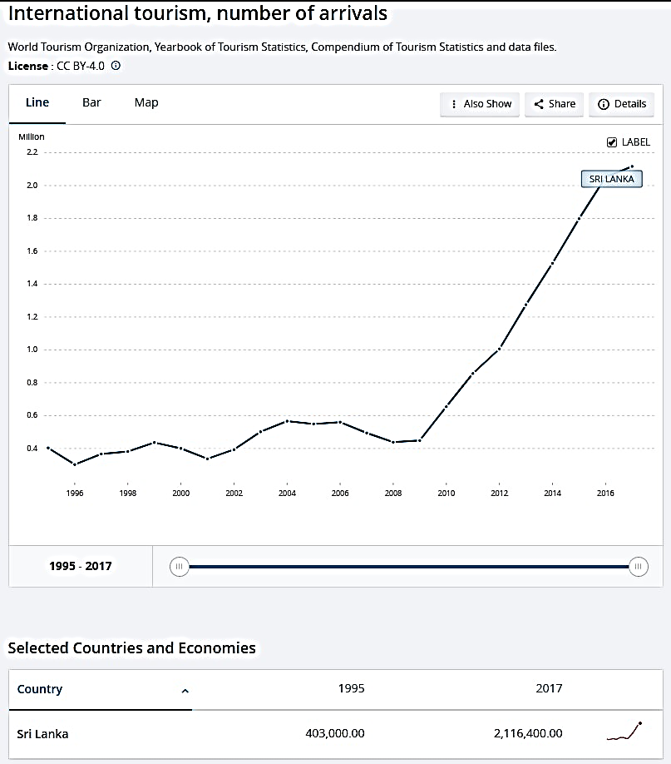
Market capability
As the number show in this left figure, tourism is undeniably one of major industries. There are many major players like Acme Lanka (Pvt.) Ltd, Andrews Travel Service Ltd, Anton Jayakody Travels (Pvt) Ltd, Columbus Tours (Pvt) Ltd. Etc.
Over these near 8 years income progressed from .5 Million to 2.2 Million. In this current situation as a new market it is very wise to implement solutions that attracts many users.

Slide 11
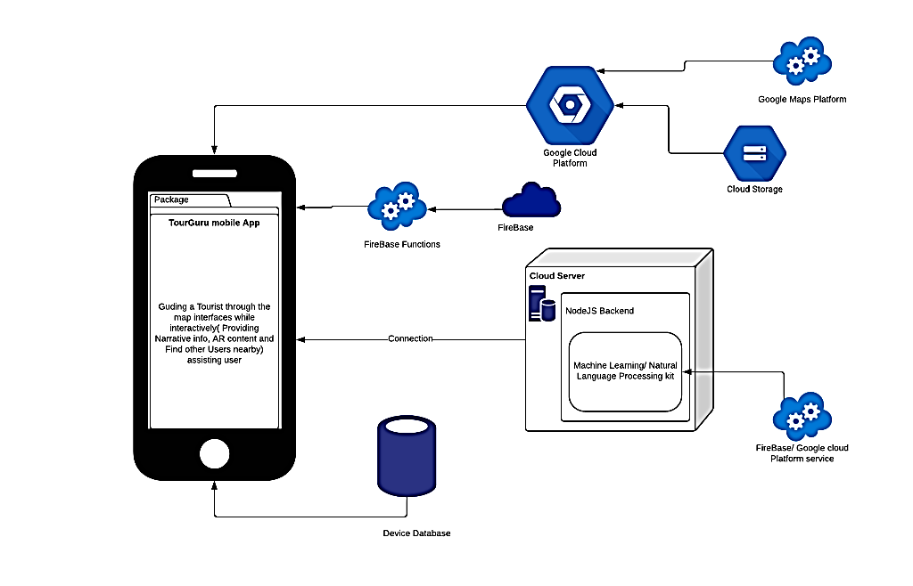
Feasibility
As our software architecture
figure in right side it is safe to say the
feasibility for implementation is
very high.
There are no region restrictions for any of these services. With the capability to market this mobile software these services may provide very convenient upgrades as we go on.

Slide 12
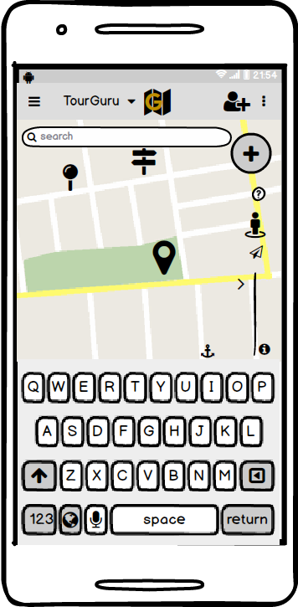
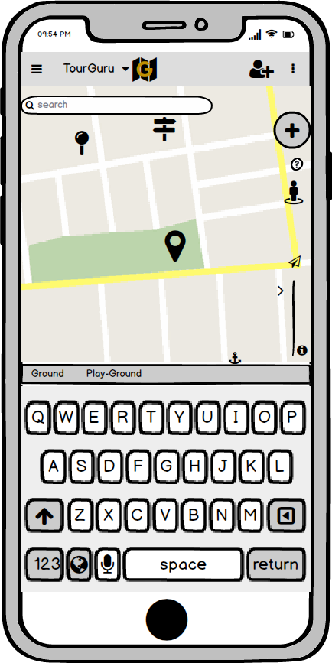
Core of the App
Core app is an Android and IOS mobile application with the user guiding through Map Interfaces, Narrations and assisting user by Question Answering and by connecting them with nearby tourists with our app.

Slide 13

Intelligent Route Mapping
R.D.T.N.Rajarathna
IT16003538

Slide 14
Research Area & Technologies
Machine Learning
Cloud Computing
Notes:
Machine Learning is used for intelligent route mapping
Cloud Computing is used for backend data server

Slide 15
Problem and Solution
Problem
Applications are not supported for walk/drive modes creatively.
It is difficult to find best routes without user collaborations.
Solution
We use walk, drive modes with better efficiency.
We use machine learning methods for track routes with users collaboration.
Using cloud storages to maintain data gathering and evaluation.

Slide 16


Maps Interfaces with Drive/Walk modes
To guide user with intelligent interfaces
Routes generation done by user flagged/ favorite places and predicted routing for another user
In walk mode user will be able to hear more information and interact with many functions
In drive mode quick proximity alerts for less interactivity.

Slide 17
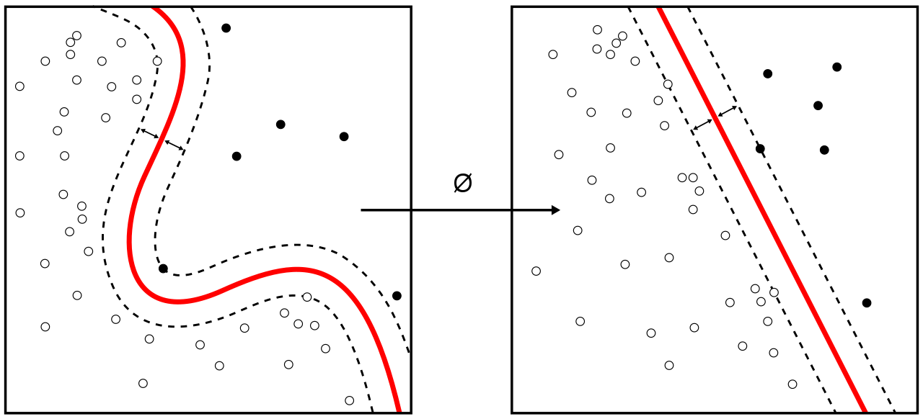

Knowledge Gap
Online map-matching based on Hidden Markov model for real-time traffic sensing applications[1].
We focus on the traveling salesman problem (TSP) and train a recurrent network that, given a set of city coordinates, predicts a distribution over different city permutations[2].
[1]C. Y. Goh, J. Dauwels, N. Mitrovic, M. T. Asif, A. Oran and P. Jaillet, "Online map-matching based on Hidden Markov model for real-time traffic sensing applications," 2012 15th International IEEE Conference on Intelligent Transportation Systems, Anchorage, AK, 2012, pp. 776-781.
URL:http://ieeexplore.ieee.org/stamp/stamp.jsp?tp=&arnumber=6338627&isnumber=6338591
[2] Neural Combinatorial Optimization with Reinforcement Learning .Bello, Irwan; Pham, Hieu; Le, Quoc V.; Norouzi, Mohammad; Bengio, Samy

Slide 18

Location Crowdsourcing and Proximity Narrations
M.S.B.W.T.M.P.S.B. Thennakoon
IT16160262

Slide 19

Research Problem
In Sri Lanka, there are Map Based Mobile Applications for Proximity narrations on the nearby attractions.
Screen interaction not appropriate while in the driving mode and should not have much Driver Interaction

Slide 20
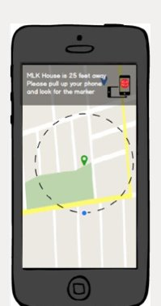
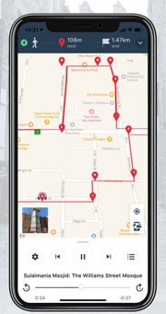
Storytelling like Narrative expeiene in tour guidance
Solution
Proximity storytelling like guidance alerts will passively alert user and notify tour change or near place update
Crowdsourced information will be used to update future users about these sourced data/ location information's
Narrations will be activated for updated database by the crowdsourcing.
Assisting Driving tourists with quick narration in the map interface drive mode
Notes:
Tourists has no time to or unable to actively engage with the mobile app.
Passively Alert: Without screen interaction narration plays like a playlist

Slide 21

Knowledge Gap
TripAdvisor: Recommendation Agent[1] Classification And Regression Trees(CART) used to review social media posts done by Tourists to select Consumer Preference rather than Crowdsourcing
Intelligent Tourist Attraction System[2] Bayesian Model utilized to get the probability of tourist attraction modelled by an EBM model.
[1] Mehrbakhsh Nilashi , Othman Ibrahim, Elaheh Yadegaridehkordi, Sarminah Samad, Elnaz Akbari, Azar Alizadeh : Travelers decision making using online review in social network sites: A case on TripAdvisor
[2] Fang-Ming Hsu, Yu-Tzeng Lin, Tu-Kuang Ho: Design and implementation of an Intelligent Tourist Attractions System (ITAS) for tourist attractions: The integration of Engel–Blackwell–Miniard (EBM) model, Bayesian network and Google Maps
Notes:
EBM: Decision-Making Model Of Engel, Blackwell And Miniard (1995)

Slide 22
Comparison
Toureazy Only for Location Alert about notifying user reaching the Point Of Interest(POI) and providing their AR content which is limited.
Roadtrippers Crowdsourcing locations for, on-route discovery rather than generating location information
TourBuddy AR based solution with Traffic Management,

Slide 23
Research Areas
Software Engineering: Cross-Platform Mobile Application
Cloud Computing: Text summarization, creating narratable content done in a deployed cloud backend(Baas)
Cloud Database: Crowd-Sourced database should be 24/7 available
Natural Language Processing with Deep Learning(Subset of Machine Learning)
Notes:
BAAS-Backend as a service

Slide 24
Using AR to identify a location, monument, ruins and other attractions
M.P.D.S.M kumara
IT16117488
Notes:
Main purpose create real world environment area in real time.

Slide 25
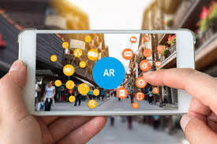
Research Area
Augmented Reality (AR)

Slide 26
Research Problem and Solution
Tourists can not feel ancient monuments, ruins so we can use Augmented Reality(AR) based solution for this problem

Slide 27
Augmented Reality (AR)
The user can hold the device towards the general direction of a certain monument and the app will show some AR content related to that monument.
Eg: Object Model, historical references, special attributes, images
Location information (Historical, Attributes, Queried information …etc..) will be processed for identified place/monument.
The AR content will be displayed on the mobile device by the user choosing(object image 3D,2D)
Notes:
1.User direct the device or its camera to a general location
2.Device will process the following place/ monument.
3.Information queried from internal, external databases regarding identified location information
4.AR content will be displayed for Identified location

Slide 28
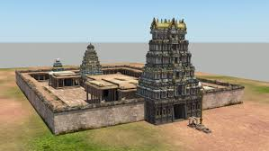
3D model Constructor
Collect the details via history books and imagine the kingdom.
Create the sketch of 3D models
Then create fully completed 3D Models and export to Unity. Authors propose Unity3D for create mobile interface and integration 3D models into real environment
Notes:
All the relevant functions were written in C# and embedded into Unity gameobjects.
Give the some short information.

Slide 29
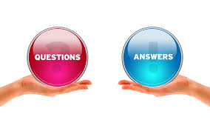
Q & A( question and provide answer )
One of most important features that is at the core of the application is that it will be able to identify the users question content and provide answer content
Notes:
Using NLU(Natural Language Understanding)
Steps; 1. Understands whole sentences
2. Keyword Search(Users can use keywords to find relevant questions from the Designing QA database. Keywords are a fast way to find simple information. )
***Nlu compared algoritham: LUIS(Language Understanding Intelligent Service),RASA. best results from Evaluating Natural Language Understanding Services for Conversational Question Answering Systems(http://www.aclweb.org/anthology/W17-5522).
***RASA :Rasa NLU is an open-source natural language processing tool for intent classification and entity extraction in
chatbots.

Slide 30

Q&A
This component will use Natural Language Understanding to process user’s question and separate its important phrase and querying it to get the answer from well-known online databases/sites. (Wikipedia, Google etc.)
Notes:
For the question given by the user for this location, answer will be generated automatically.
User can ask the question in testing mode and speaking mode.
But app is generated by text answer only.
1)user request analysis /returning the response(Eg;Smartifik,google assi.)

Slide 31

UX Testing
This component will look into Testing the UX using HCI evaluation techniques and using them to improve the user interface.

Slide 32
Ways of Conducting HCI evaluations
Formative
Check functionality
Requires small amount of users
Summative
real life use
User satisfaction
E.g.: heuristic evaluation:
assessment of digital experience to identify usability issues
which conflict with known practices

Slide 33
Ways of Conducting HCI evaluations
Behavioral
Observing user behavior
Attitudinal
Self-reported by users
Quantitative
Usability tests
Qualitative
field study(observe user behavior)
survey

Slide 34
Ways of Conducting HCI evaluations
Controlled environment
focus groups
lab usability test
interviews
Contextual environment
remote usability test
field studies
video studies
Intercept studies

Slide 35
Adding a social network aspect to the app
Mine data from users depending on their permissions.
Create a platform for users to interact

Slide 36

THANK YOU

